Slide 1
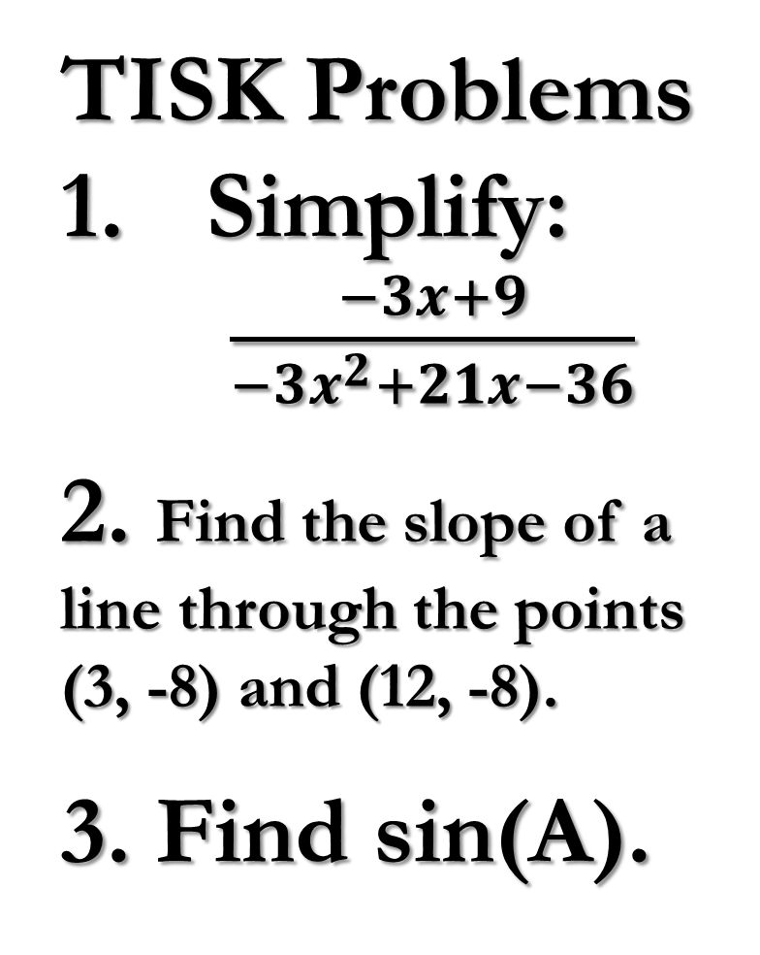
Friday,
Feb. 22, 2013
TISK Problems
Simplify:
$\frac{−3x+9}{−3x^{2}+21x−36}$
2. Find the slope of a line through the points (3, -8) and (12, -8).
3. Find sin(A).
Agenda:
TISK & No MM
HW Check
Lesson 10-1: Polygons
Homework: 10-1 problems in packet
A
35
21
C
B

Slide 2


HW Check
0.4226
0.9848
0.5000
0.3584
0.9744
0.4848
4.0108
0.5000
2.4751
0.5317
$\frac{7}{24}$
$\frac{9}{13}$
$\frac{17}{19}$
$\frac{8}{17}$
$1$
$2$
$\frac{4}{5}$
$\frac{12}{13}$
$\frac{3}{5}$
$\frac{5}{12}$

Slide 3
§10.1 Polygons
Definitions:
  Polygon
    A plane figure that…
      Is formed by 3 or more segments called sides and…
      ..each side intersects exactly 2 other sides, one at each endpoint.
Polygon
Not a Polygon

Slide 4
Definitions…
§10.1 Polygons
Convex
  No line that contains a side of the polygon also contains a point in the interior of the polygon.
Concave
  Not convex (also called nonconvex)
  Has a “cave in”

Slide 5
§10.1 Polygons
Equilateral
  All sides are congruent
Equiangular
  All angles are congruent
Regular
  Both equilateral AND equiangular

Slide 6
§10.1 Polygons
Diagonal
  A segment that joins two nonconsecutive vertices.

Slide 7
Names of Polygons
§10.1 Polygons
Name | Number of Sides
Triangle
3
Quadrilateral
4
Pentagon
5
Hexagon
6
Heptagon
7
Octagon
8
Nonagon
9
Decagon
10
Dodecagon
12
n-gon
n

Slide 8
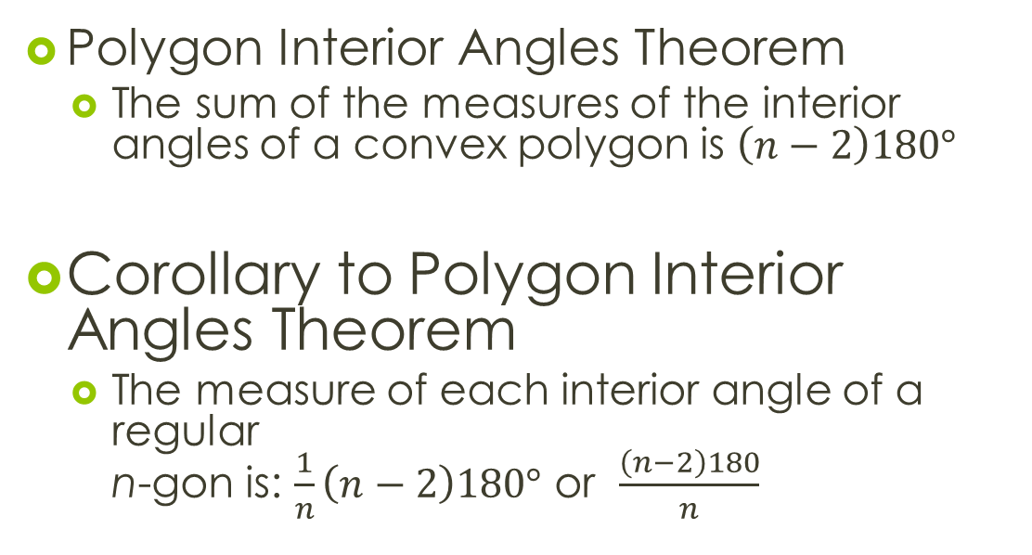
Interior Angles
§10.1 Polygons
Polygon Interior Angles Theorem
  The sum of the measures of the interior angles of a convex polygon is $\left(n−2\right)180°$
Corollary to Polygon Interior Angles Theorem
  The measure of each interior angle of a regular
  n-gon is: $\frac{1}{n}\left(n−2\right)180°$ or $\frac{\left(n−2\right)180}{n}$

Slide 9
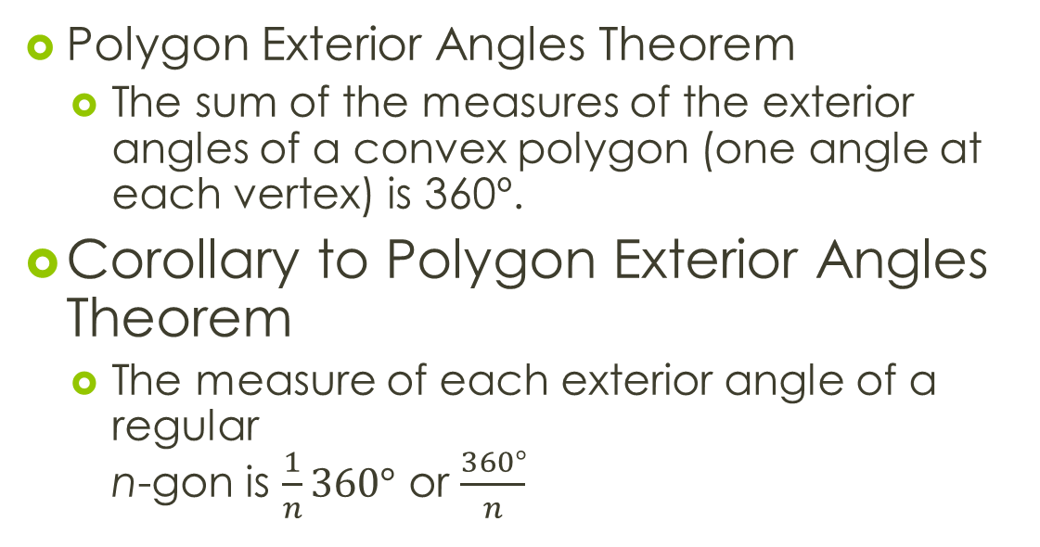
Exterior Angles
§10.1 Polygons
Polygon Exterior Angles Theorem
  The sum of the measures of the exterior angles of a convex polygon (one angle at each vertex) is 360º.
Corollary to Polygon Exterior Angles Theorem
  The measure of each exterior angle of a regular
  n-gon is $\frac{1}{n}360°$ or $\frac{360°}{n}$

Slide 10
Practice
§10.1 Polygons
If each interior angle of a regular n-gon is 108º, how many sides does the polygon have?

Slide 11
Practice
§10.1 Polygons
Find the value of x.

